Slide 1
Module 2 Fundamentals of reproducible science

Slide 2
Why is reproducibility important?
The scientific method requires that work can be falsified or verified by others
If something new is discovered, it should be true at any point in time and in anybody’s hands
Your own analysis requires reproducibility
Checking for errors
Preparing a manuscript
Having to tweak something after manuscript reviewers propose changes or have questions
Having someone else use your work for future work
The divide between wet and dry experiments needs to be eliminated
A project should be one, big experiment and not fragmented
Grant applications
NIH now requires a section on scientific rigor

Slide 3
Reproducible
An experiment is considered reproducible if a different research team can obtain its input data, its computational tools, understand them, and rerun the same methods to achieve the same result.

Slide 4
Replicability
A different research team can start with the same concept, and perhaps overlapping information, but regenerate their own data and methods that ultimately produce the same result.

Slide 5
Reproducibility: data vs analyses
Reproducibility of data: more about files – where you put them and how you manage them
Example: databases with notations for data
Reproducibility of analyses: more about programs, code and workflows
Example: literate programming or revision control repositories for code that carries out analyses

Slide 6
Controls
Positive controls: Experimental inputs for which a known result or output is expected. These can be pre-specified and automatically checked throughout the analysis process.
Also referred to as unit tests
Can be pre-specified and automatically checked throughout the analysis process
Negative controls: Null inputs for which no or an uninteresting result is expected and can be checked.
Controls should always be included, and checked automatically if possible, at each stage of the study intended to be reproducible.

Slide 7
Reproducibility: electronic vs protocol
Electronic reproducibility: activities that a computer can carry out for you.
Checking assertions, control results, or unit tests
Storing documentation or data in a particular repository
Managing revision control history for an analysis workflow.
Protocol reproducibility: activities and best practices you must do yourself.
Using a revision control repository or a public database
Designing your experiment to support convenient reproducibility by others
Picking a consistent naming scheme for your files and folders
Writing enough documentation for another user or your future self to read and understand

Slide 8
Factors Affecting Reproducibility
Data size (volume, velocity, or variety)
Consider a distributed file system in parallel processing
Streamed processing that can save progress, start and stop as needed
An explicit annotation process, automated if possible, that captures where new files are coming from, at what time, and who’s responsible for them
Use a data store such as the Open Science Data Framework that provides detailed typing, metadata, and cross-file integration

Slide 9
Factors Affecting Reproducibility
Data complexity
Look at small snippets of data from the input and output of each step of your analysis process
Include positive and negative controls - simulations and tests
Make plots or summary statistics that will reveal problems, outliers, or unwanted technical patterns

Slide 10
Factors Affecting Reproducibility
Data History
Input data should always have an explicit source, such as a URL, and a time and date stamp
All data should have the contact information for one or more responsible parties associated with it
Analysis data products should be annotated with exactly what programs and parameters were used to generate them
Information can be captured formally (workflow or database), or informally (readme file)

Slide 11
Experimental Design
“It doesn’t matter how beautiful your theory is, it doesn’t matter how smart you are. If it doesn’t agree with experiment, it’s wrong”
Richard Feynman
A good experimental design is one of the key elements for assuring your research is reproducible

Slide 12
Basic Principles of Experimental Design
1. Formulate a hypothesis/scientific question/specific goal
2. Perturb the system in some way in order to test the hypothesis
3. Consider the experimental condition and suitable controls
4. Think about the analytical plan
5. Ensure sufficient replication
power calculations
6. Include randomization
Stratification (blocking): the arrangement of samples into groups/blocks
Factorial experiments: the testing of multiple variables at the same time
7. Ensure the data and analytical plan can actually achieve the goals you want to achieve

Slide 13

Organization
A quick guide to organizing computational biology projects
William Stafford Noble, 2009
PLOS computational biology
File and directory organization
The lab notebook
Carrying out a single experiment
Handling and preventing errors
Command lines vs scripts vs programs
The value of version control

Slide 14
Directory Structure

Slide 15
Naming Files and Folders
Name files with a type, topic, subtopic, and date
Example: Curtis gave a presentation for the Human Microbiome Project on inflammatory bowel disease on June 21, 2016.
File name: “presentation_hmp-ibd_06-21-16”
For figures, folder name “Figures”
For scripts, folder name “Source”
For writing a manuscript, subfolder name “Data”
For supporting documents, folder name “Supp”

Slide 16
Lab Notebook
Chronologically organized
Describe precisely what you did and why
Record your observations, conclusions, and ideas for future work
Transcribe notes from conversations as well as email text
Share with advisor, collaborator, lab group, research team, etc.
Password protected if needed

Slide 17
Electronic Lab Notebook
Online wikis
Code repositories
GitHub
Bitbucket
Document sharing tools
Etherpad
Evernote
OneNote
Google Keep
Dropbox
The specific tool is not important. Using tools and being consistent are.

Slide 18
Thinking of others/future work
"We are like dwarves sitting on the shoulders of giants. We see more, and things that are more distant than they did, not because our sight is superior or because we're taller than they, but because they raise us up, and by their great stature add to ours.”
John of Salisbury, 1159
All of the science we do builds on past work
Making your work reproducible will ensure others can build upon it

Slide 19
Basic Principles to Ensure Continuity
1. Describe your hypothesis and clearly lay out your plan
2. Describe any potential confounders
3. Ensure the data is in a standard format, well annotated and consistent
4. Use clear/intuitive data file names
5. Make the data available on a public repository (if possible)
6. Provide adequate metadata to interpret the results

Slide 20
Basic Principles to Ensure Continuity
7. Provide raw data
8. Ensure software is well written and code well commented
9. Use clear/intuitive variable names
10. Have someone else review and test your code
11. Make the code publicly available
12. Make your software streamlined
13. Provide at least one working example

Slide 21
Workflows
1. Create an automated workflow
Doit
Snakemake
Taverna
Kepler
Jupyter (IPython)
Knitr
Make
2. Have your workflow automatically capture annotations
Which programs you ran, what their parameters were, how each output file was created
3. Rerun your analysis in a new computation environment, or have someone else run it
4. Automated or semi-automated deposition
Sending results to the journals or databases where they will be published

Slide 22
Assessment #1 Transform the following small data set to make it appropriate for analysis.
Drug A | Age of patient | Patient gender | Height | Tumor stage | Date enrolled | Complications?
1 | 25 | Male | 61” | 1 | 1/15/99 | no
2 | ? | female | 5’8” | 2 | 2/1/1999 | y
3 | 40 | male | 120cm | IV | 2/13/99 | No
Drug B
1 | unknown | m | 5’6” | 3 | Jan 98 | yes
2 | 22 | f | 5’ | III | 3-1999 | Y
3 | 31 | ? | 172 | 4 | ? | n
4 | 5 | M | NA | II | Last fall | N

Slide 23
One example answer Note that missing values (‘?’, ‘unknown’ and ‘NA’) have been replaced with -1 to designate a missing value for consistency. Height has been converted to inches. Binary variables (Drug, Sex, Year enrolled, indicator of complications) have been coded as 0/1. Tumor stage has been made an integer.
ID | Drug (0:A, 1:B) | Age (years) | Sex (0:Male, 1:Female) | Height (inches) | Tumor stage | Year enrolled (0:1998, 1:1999) | Complications? (0:No, 1:Yes)
1 | 0 | 25 | 0 | 61 | 1 | 1 | 0
2 | 0 | -1 | 1 | 68 | 2 | 1 | 1
3 | 0 | 40 | 0 | 47 | 4 | 1 | 0
4 | 1 | -1 | 0 | 66 | 3 | 0 | 1
5 | 1 | 22 | 1 | 60 | 3 | 1 | 1
6 | 1 | 31 | -1 | 172 | 4 | -1 | 0
7 | 1 | 5 | 0 | -1 | 2 | 0 | 0

Slide 24
Assessment #2
Suppose you are starting a new research project that involves breast cancer prediction. On August 1st, 2017 you received two data sets contained in two separate .txt files. One set of data was collected from individuals in Boston, Massachusetts, and the other from individuals in Los Angeles, California. You perform a preliminary round of data cleaning and save two new data files on August 15th, 2017. Using the cleaned data files, you perform an exploratory data analysis that includes summary statistics and figures as output. After presenting these results to your PI, it is suggested you perform another round of data cleaning, exploratory data analysis and then a statistical analysis. You save two new data files and exploratory data analysis results on September 1st, 2017. You write code to perform a statistical analysis on September 5th. However, you notice a problem with this version of the code and save an updated version on September 15th. Then, you run the code file(s) and save the output on September 30th. You start preparing a manuscript on October 1st and present a draft to your PI. They make several suggestions which include a tweak in your statistical analysis. You update your code on October 15th, and save new output on October 16th. A new draft of the manuscript is saved on November 1st. You present this draft to your PI. You save a third draft on November 15th, a fourth draft on November 30th, and a final draft on December 1st.
Create a directory structure diagram for this example project. Be sure to include the names of all directories and files, similar to the figure shown in the video in submodule 02_04b. Keep in mind the organization tips presented in the videos.

Slide 25
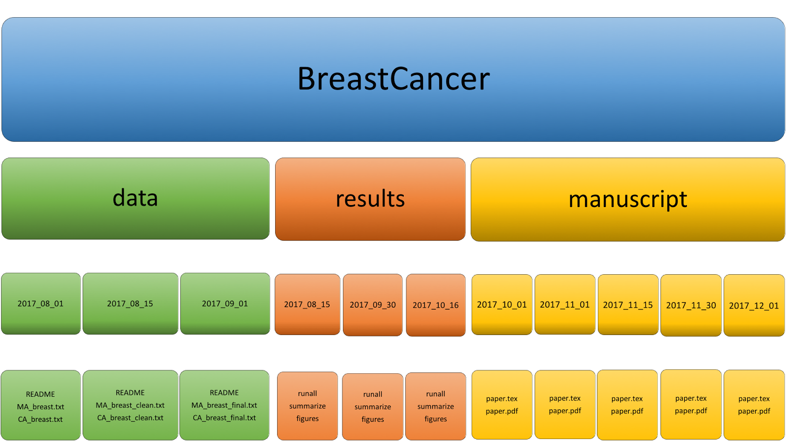
One example answer

